Slide 1
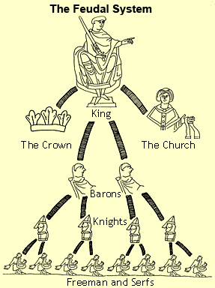
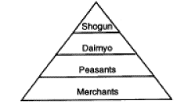
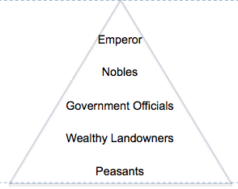
What do all three have in common?
All three societies have a ruler who has absolute, or total, control.
JAPAN
EUROPE
CHINA

Slide 2
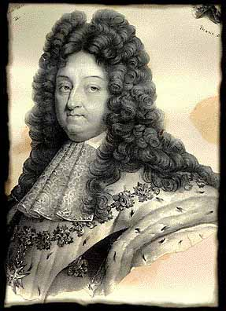
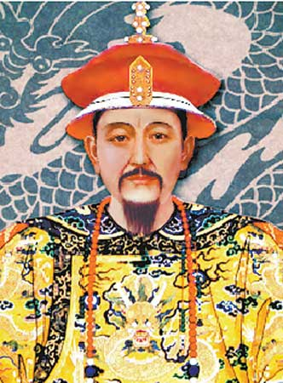
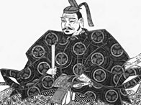
What is an absolute ruler?
Someone who has unlimited power
Total control over the people
EUROPE
CHINA
JAPAN
Louis XIV
France
Peter the Great
Russia
Tokugawa
Kangxi

Slide 3
Absolute Monarchs
Monarchs + Absolute Power
Total Control
over the People
Believed in the idea of divine right, meaning that monarchs acted as god’s representative on earth.
An absolute monarch answered only to god, not to the people.

Slide 4
Causes of Absolutism
Urbanization at the end of the Middle Ages centralized the power of monarchs.
The Reformation reduced the power of the church and expanded the power of monarchs.
The Age of Exploration strengthened European economies and expanded the power of monarch.
Wars led to the growth of militaries and increased taxes to pay for them.

Slide 5
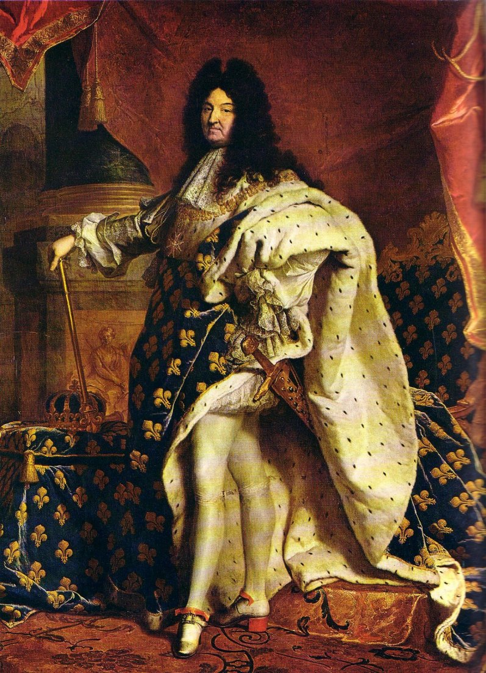
Louis XIV 1638-1715
France
Came to power at a young age (4 years old)
While he was young, France was ruled by a Catholic cardinal who strengthened central government and raised taxes.
He hated and feared the noble class because they threatened his power.
Took control at age 22.
Believed that he and the state were one and the same. “I am the state.”

Slide 6
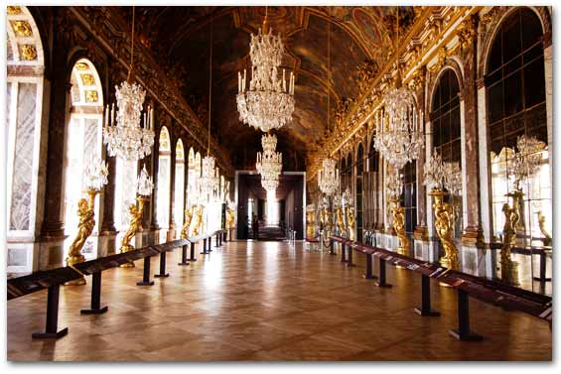
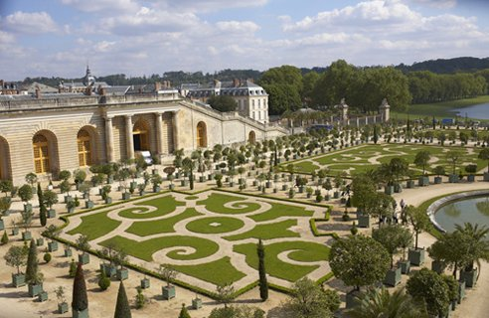
Louis XIV 1638-1715
Lived a luxurious lifestyle and promoted the arts. He required hundreds of nobles to live with him.
He called himself the “Sun King.”
He supported mercantilism.
He fought wars to expand the size of France.
When he died, he left France with a large amount of debt.

Slide 7
Peter the Great 1672-1725
Took power at a young age (24 years)
Took a long journey to Europe
Wanted to learn about new technology and customs
Wanted to compete with Europe militarily and economically

Slide 8
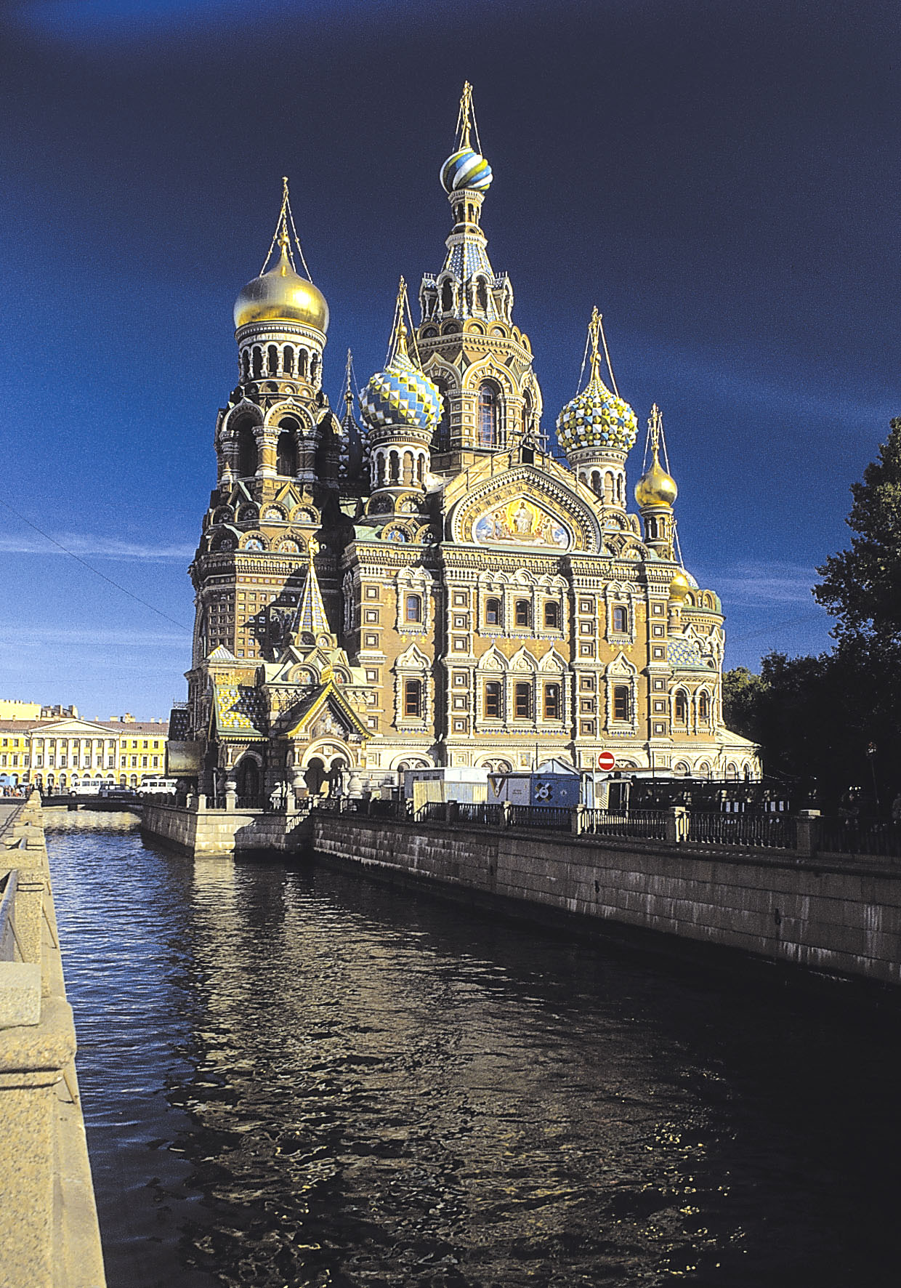
Peter the Great 1672-1725
Built a new Russian capital named St. Petersburg
Brought the church under his control and eliminated the office of Patriarch
Reduced the power of the nobility by taking away their land
Strengthened the Russian army and raised taxes to pay for it
Declared war on neighboring countries to gain access to seaports

Slide 9
Absolute Monarchs of Europe
Louis XIV
Peter the Great
France
Russia
Came to power at a young age
Promoted education
Promoted the arts
Reduced the power of the nobility
Traveled to Europe and wanted to make Russia more western
Lived a luxurious lifestyle
Declared war to expand boundaries
Left France with a large amount of debt
Strengthened army
Brought the church under his control
Raised taxes

