Slide 1
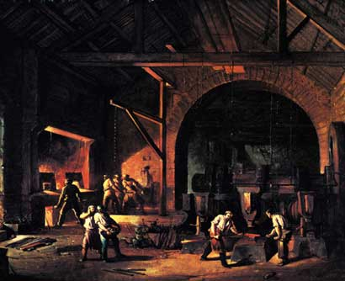
Effects of the Industrial Revolution
5.2
(1750-1914)
Notes:
Part of a series (5.1 to 5.8)

Slide 2
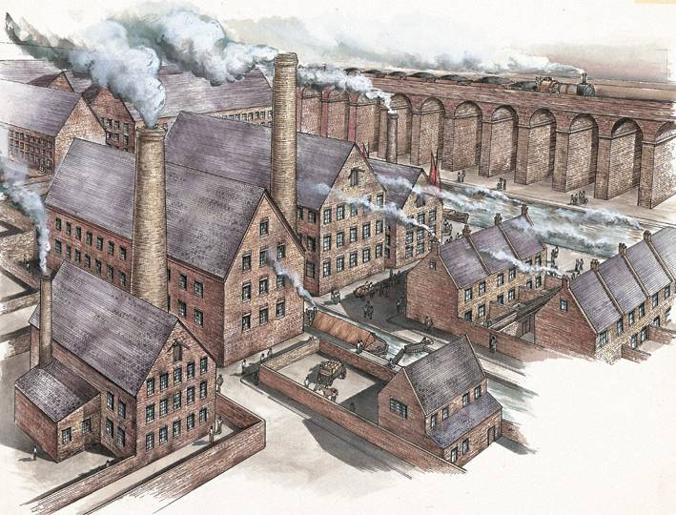
Effects of Rapid Industrialization in the early to mid-1800s

Slide 3
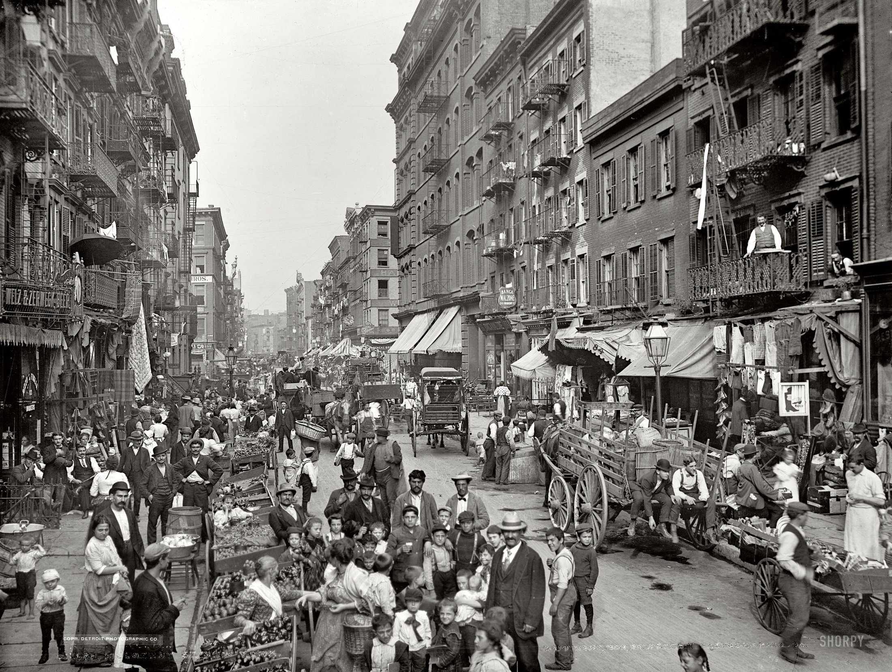
1. Urban explosion- because of farm
machines and population increase,
millions moved to cities (urbanization)

Slide 4
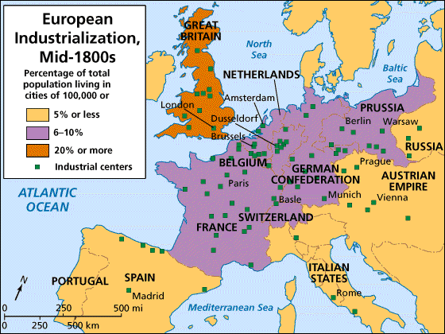

Slide 5
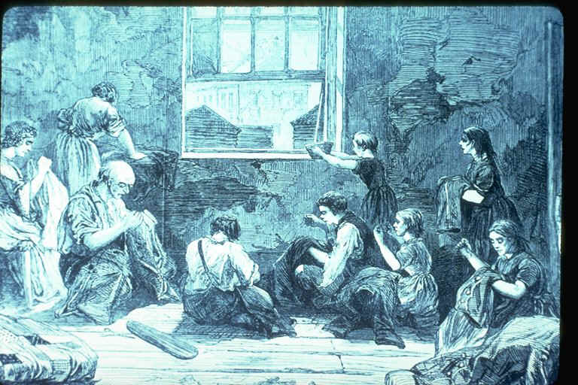
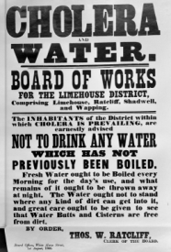
Large cities suffered from inadequate sewage systems, crowded and unsafe housing,
pollution, labor unrest, and crime

Slide 6
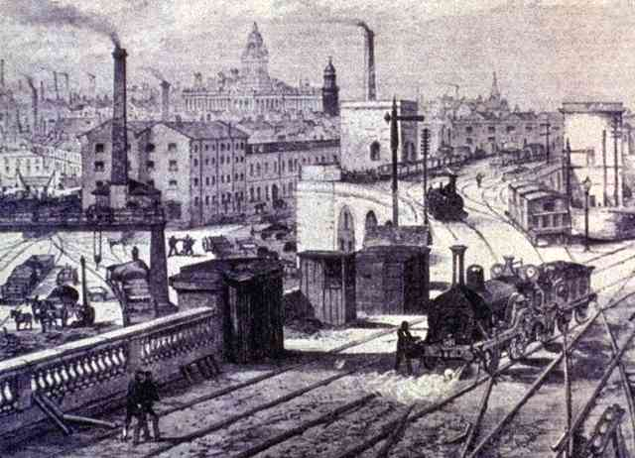
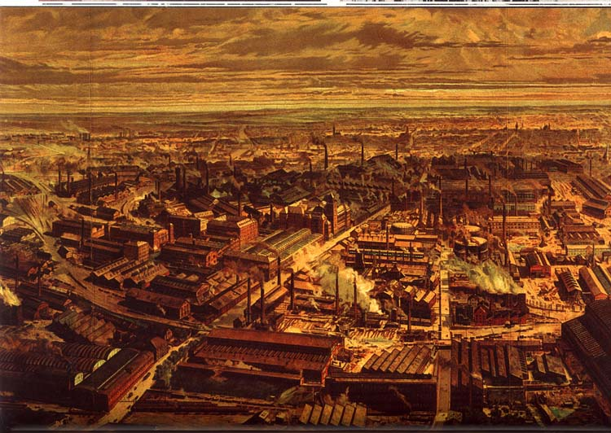
Industrial Cities
Manchester, England (1855)

Slide 7
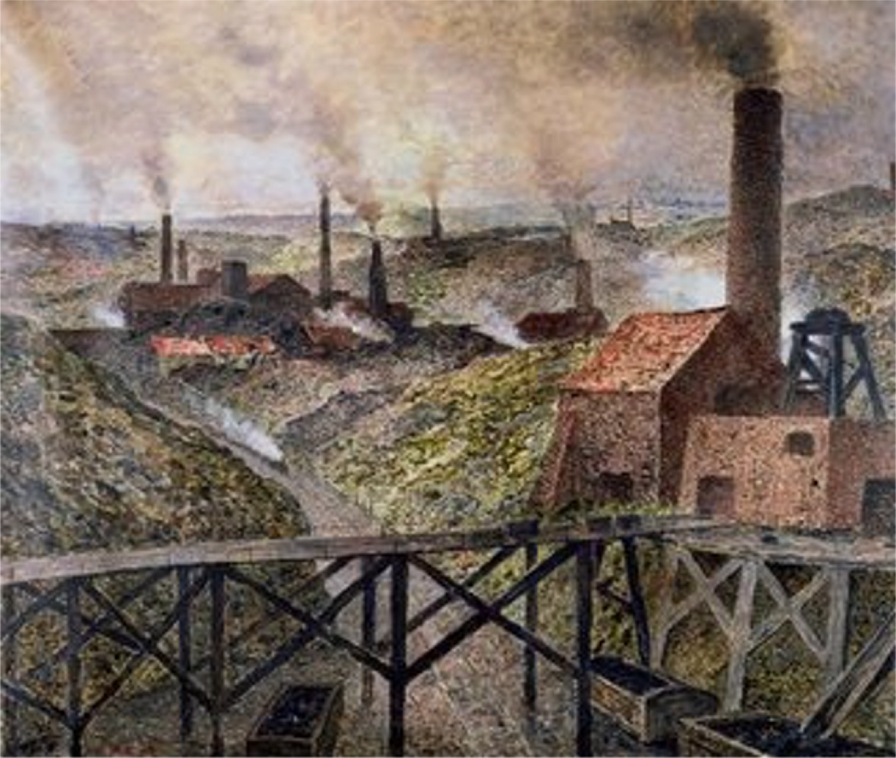
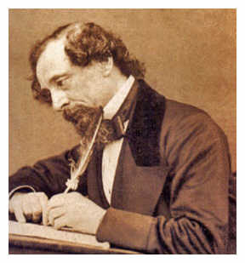
“It was a town of red brick, or of brick that would have been red if the smoke and ashes had allowed it; but as matters stood, it was a town of unnatural red and black like the painted face of a savage. It was a town of machinery and tall chimneys, out of which interminable (endless) serpents of smoke trailed themselves for ever and ever, and never got uncoiled. It had a black canal in it, and a river that ran purple with ill-smelling dye, and vast piles of building full of windows where there was a rattling and a trembling all day long, and where the piston of the steam-engine worked monotonously up and down, like the head of an elephant in a state of melancholy (sad) madness.”
--Charles Dickens, Hard Times (1854)

Slide 8
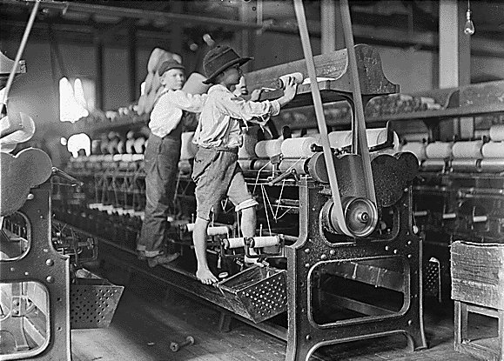
2. Working Conditions- often whole families were forced to work 12-16 hour days for low wages, factories very unsafe
Textile factories often employed young children. Why?

Slide 9
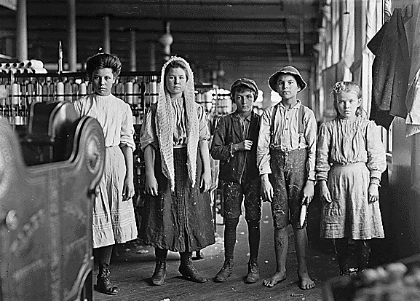

Textile Factories

Slide 10
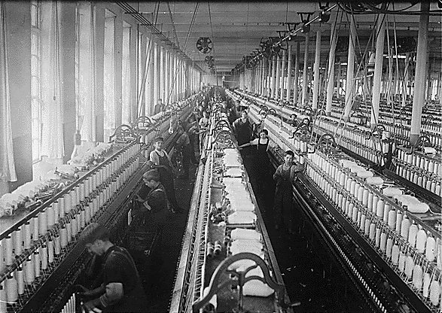

Slide 11
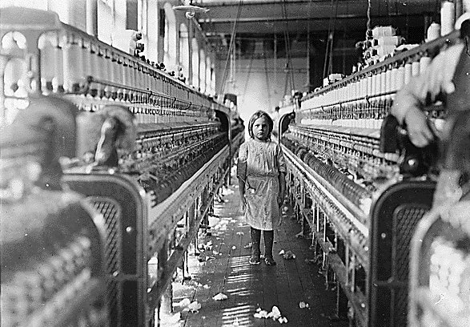

Slide 12
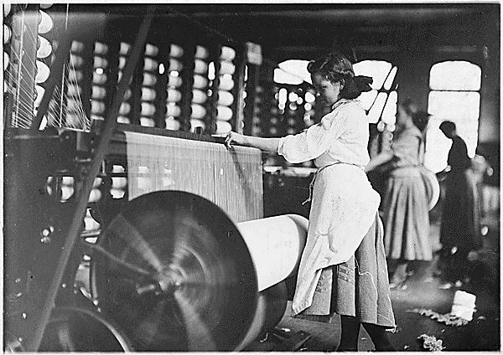

Slide 13
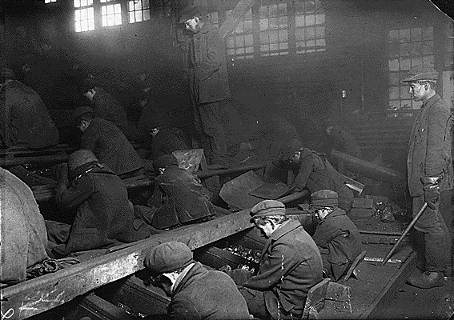
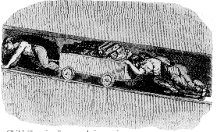
Child labor in Mines

Slide 14
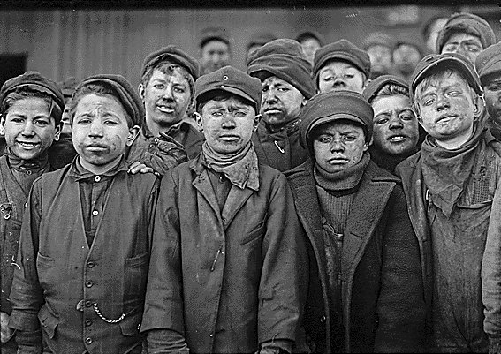

Slide 15
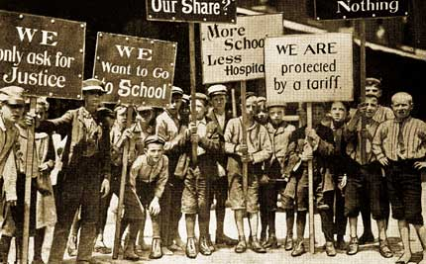

Slide 16

Think About It...
*What could the workers do to improve their working conditions?
*Who could the workers ask to help them that would be strong enough to enforce reforms?

Slide 17



3. The Industrial Revolution led to systems of modern economics

Slide 18
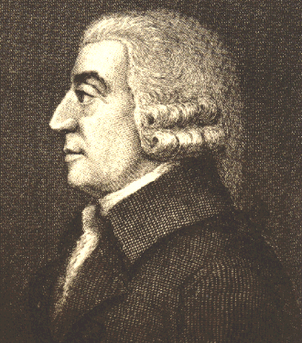
Adam Smith- wrote Wealth of Nations (1776), explained modern
i. Capitalism- means of production and property owned and run by private citizens (not the government)
“It is not out of charity that you get your dinner from the butcher or baker, it is provided from their own self-interest…. they intend only for their own gain, led by an “invisible hand” which is to the benefit of all.”
“It is not out of charity that you get your dinner from the butcher or baker, it is provided from their own self-interest……although they intend only for their own gain, they are led by an “invisible hand” which is to the benefit of all.”
Adam Smith 1723-1790

Slide 19
ii. Capitalism based on a laissez-faire government philosophy (let the economy run itself), competition, and profit motive ($)
iii. ideas embraced in US & W. Europe
LAISSEZ-FAIRE HOUSE
Now I can do whatever I want!
ECONOMY JOE
GOVERNMENT DAD

Slide 20
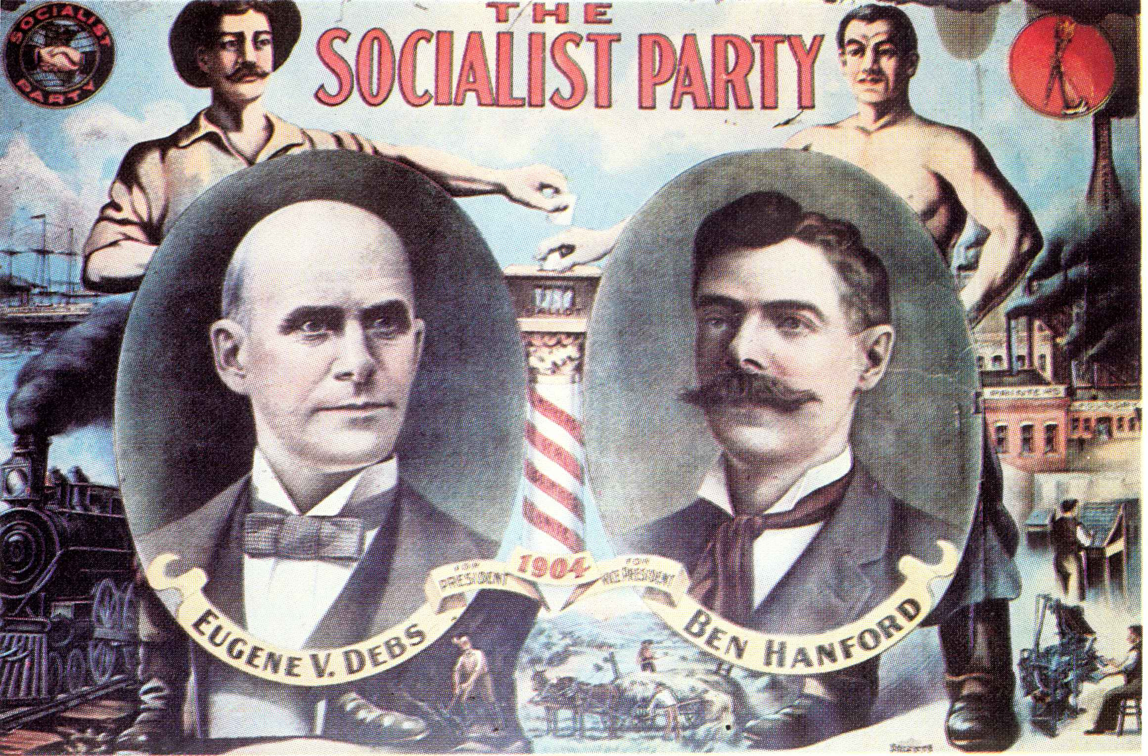
b. By mid-1800s Socialism developed- government should control economy, redistribute wealth through social welfare programs, embraced by working poor

Slide 21
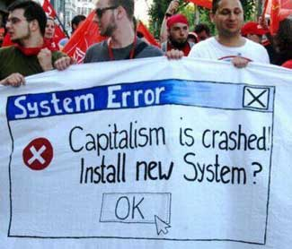
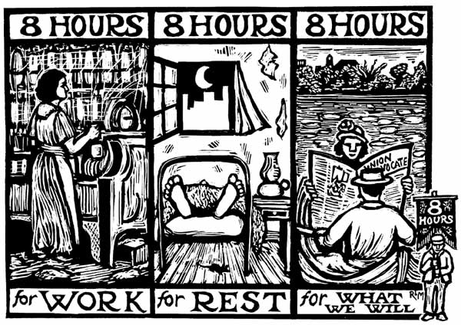
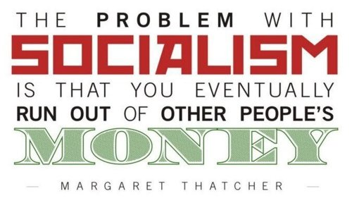


Slide 22
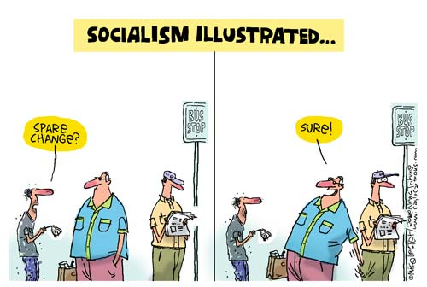
Rich
Poor
Government

Slide 23
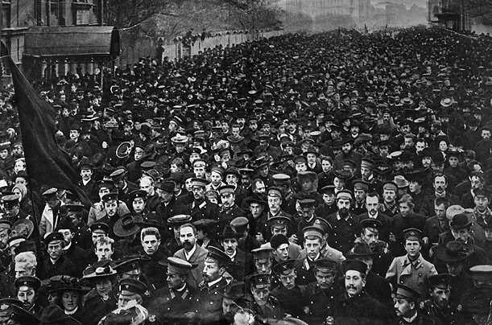
c. Karl Marx believed poor workers needed a violent revolution to gain control of the economy and the means of production

Slide 24
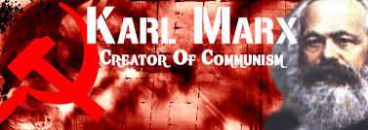
i. The Communist Manifesto (1848) described Communism- workers collectively own all property/ means of production, share equally all resources in society without social classes, ideas largely rejected until 20th century

Slide 25

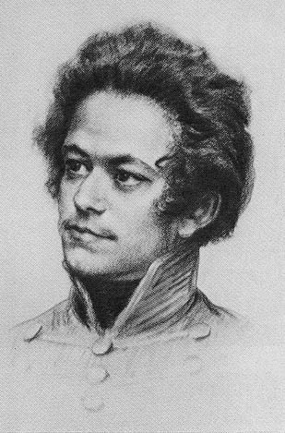
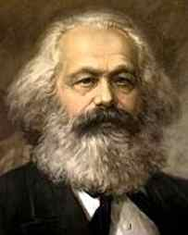
“The production of too many useful things results in too many useless people.”
Karl Marx
(1818-1883)
“Religion is the opium of the masses.”
“From each according to his abilities, to each according to his needs.”
“Workers of the world unite! You have nothing to lose but your chains!”

Slide 26
Karl Marx and Freidrich Engels
The Communist Manifesto
Haves | Have-nots
Patrician | Plebeian
Noble | Serf
1st & 2nd Estates | 3rd Estate
Bourgeoisie | Proletariat

Slide 27
The New Struggle
Bourgeoisie = owners of business, capital and means of production
Proletariat = working classes, own nothing

Slide 28

Upper class
…the truth about
Capitalism
Middle class
Lower class
TIME→
Notes:
Many different economic outcomes are possible in capitalism

Slide 29
…the truth about
Communism
Upper class
Middle class
Lower class
TIME→
Notes:
Few economic outcomes are possible in communism

Slide 30
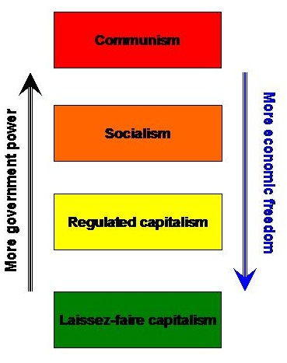
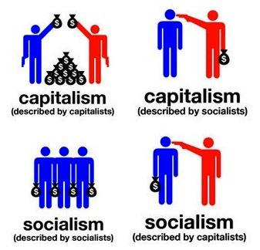


Slide 31





Economic Systems
Communism Capitalism
___________________________________
Socialism
-5 -4 -3 -2 -1 0 1 2 3 4 5
Think About It…..Where would the US fall on
this number line & why?

Slide 32
IV. Responses to the Industrial Revolution-
people demand reforms and better living
conditions for all
Rise of labor unions- once legalized, many workers joined, had the power to strike (all workers stopped working at once), gained better working conditions from business owners

Slide 33
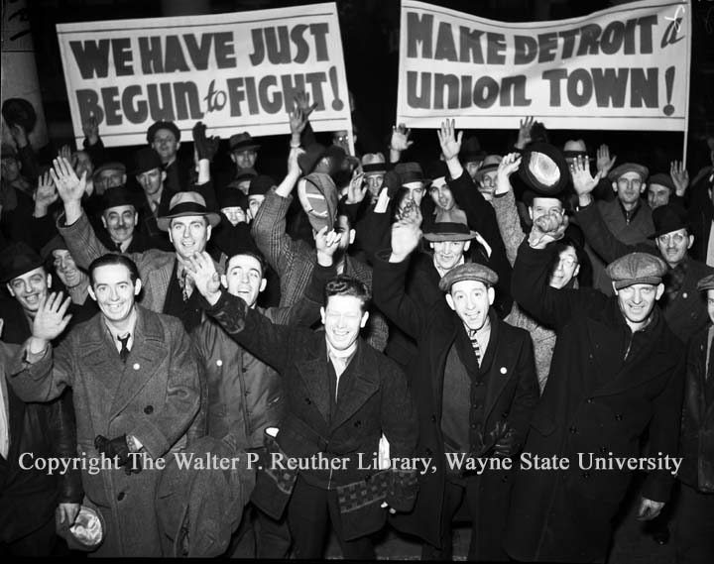
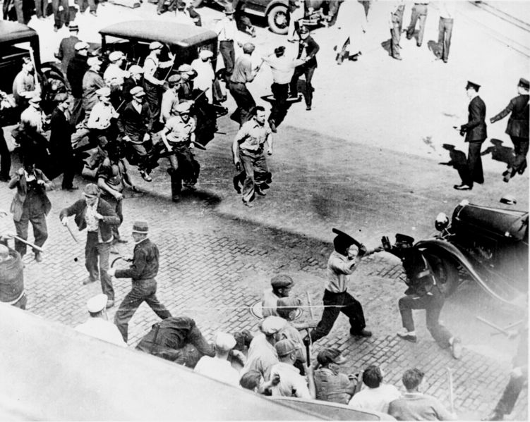
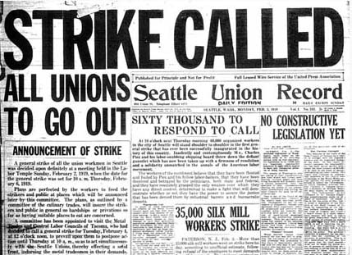

Slide 34

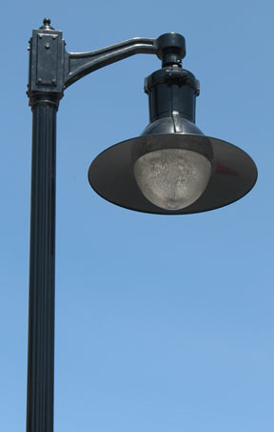
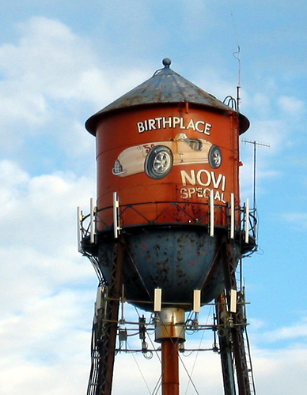

B. Through the late 1800s & early 1900s governments passed laws which enforced various reforms

Slide 35
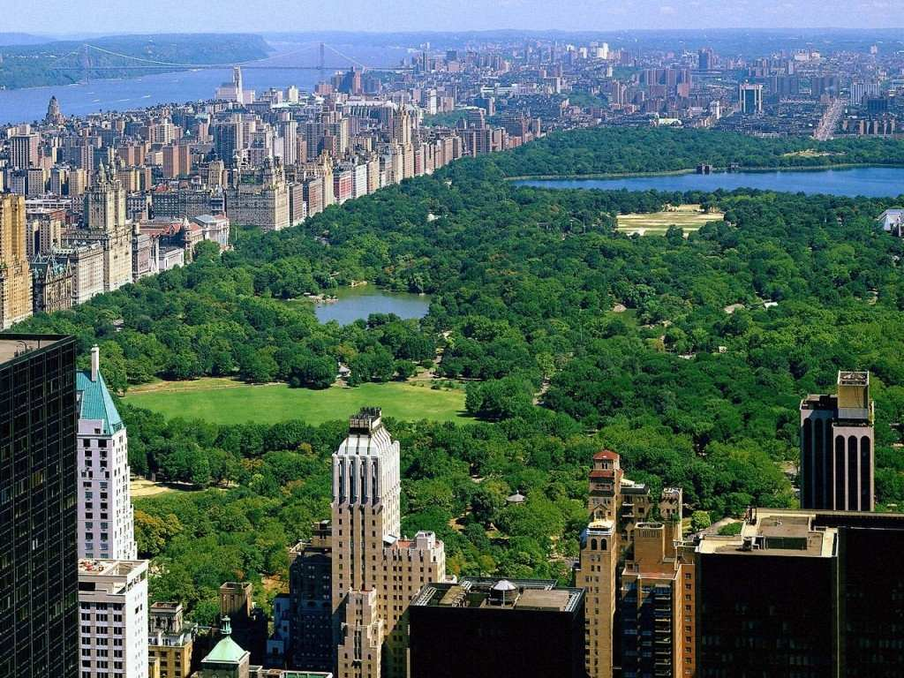
Factories became safer, people worked
shorter hours, wages increased
(minimum wage), millions moved from
poor to middle class
Central Park, New York (1859)

Slide 36
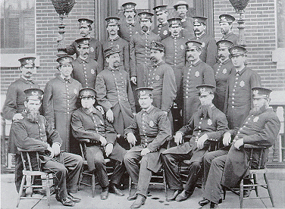
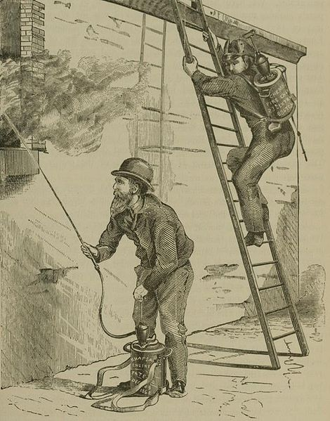
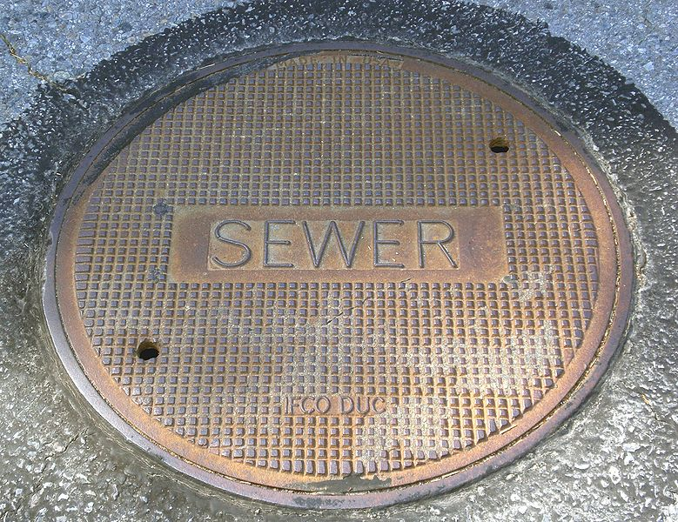
2. Cities became safer with police/fire departments, & cleaner through public sanitation projects, people lived longer

Slide 37
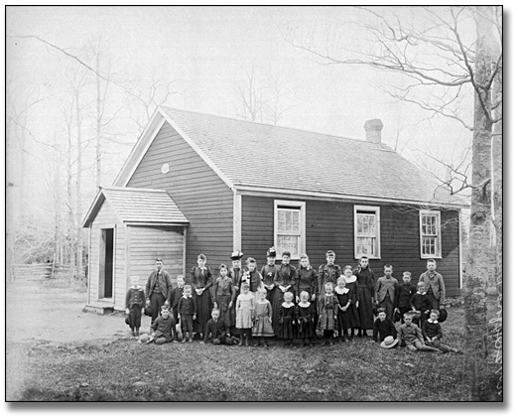
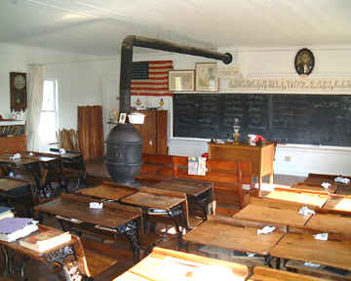

3. Child labor reduced/eliminated, children provided free public education in industrialized nations by the late 1800s

Slide 38
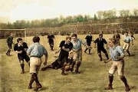
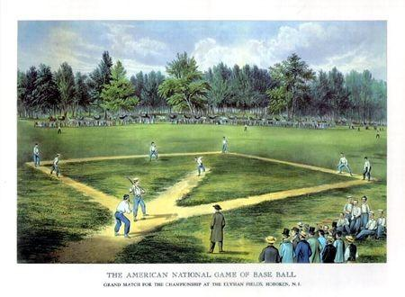
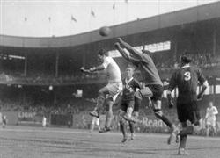
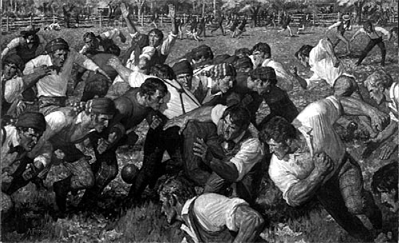
4. Workers gained more time for leisure activities such as: music concerts, radio, movies, bike riding, and sports (baseball in America, soccer in Europe)

Slide 39
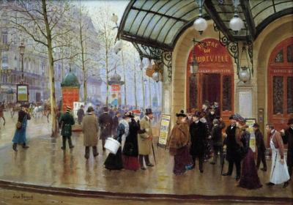
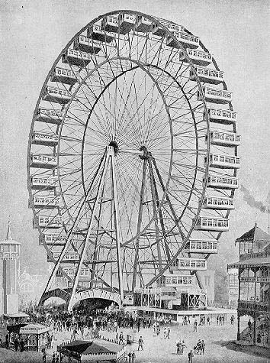
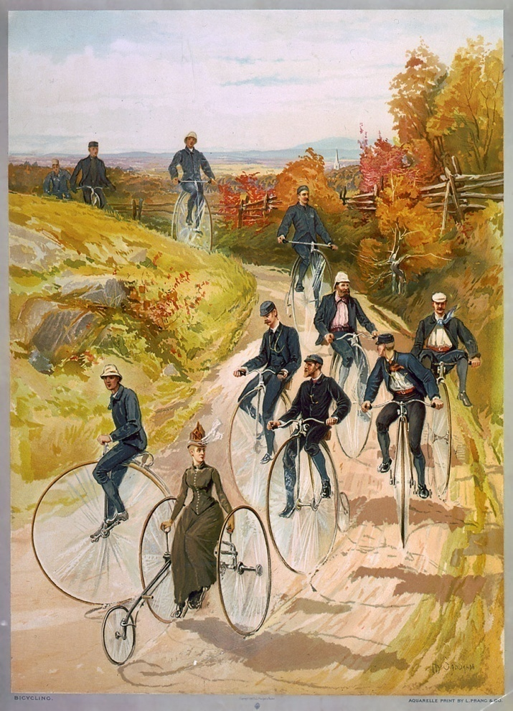
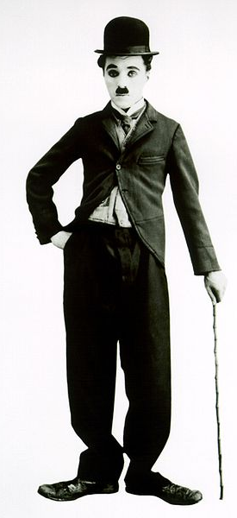
Fun Stuff!!
Notes:
George Washington Ferris wheel 1893 in Chicago, 265 feet high, each car could hold up to 60, total carrying capacity over 2,000
https://www.youtube.com/watch?v=q46MnVTEXIU

Slide 40

On a ½ sheet of paper write your name and……….
* Write a one or two sentence summary of
5.2
* Write a question you have about anything 5.2?

