Slide 1
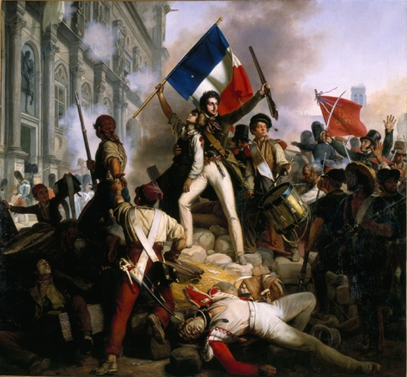
Revolutions Around the World
What were the major causes and effects of revolutions?

Slide 2
Some major causes…
First, the rejection of absolute power of the monarchy and church
Second, emphasis on freedom of religion, speech, press
Third, growing interest in the laws that governed nature and society (The Enlightenment and Scientific Revolution thing)

Slide 3
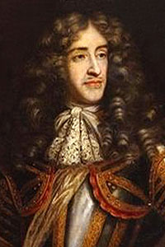
England (1689)
Causes:
Catholic King James II took power and began appointing Catholics to high government positions.
English Protestants led a rebellion known as the Glorious Revolution.
King James II (Catholic)

Slide 4
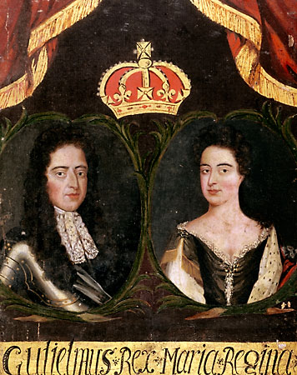
England (1689)
Results:
James protestant daughter, Mary, and her husband, William, took control of England.
William and Mary established a constitutional monarchy, limiting the power of the king with laws that were passed by the English people.
William & Mary (Protestant)

Slide 5
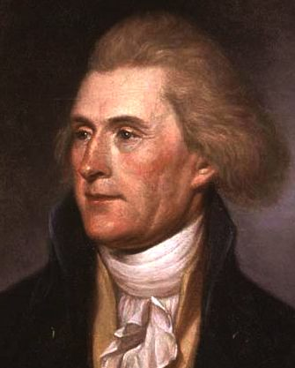
United States (1776)
Causes:
Colonists upset because they had no representation in English government
Didn’t want to pay taxes to England
Wrote the Declaration of Independence, a document heavily influenced by Locke’s theory of Natural Rights
Thomas Jefferson
(Author of the Declaration of Independence)

Slide 6
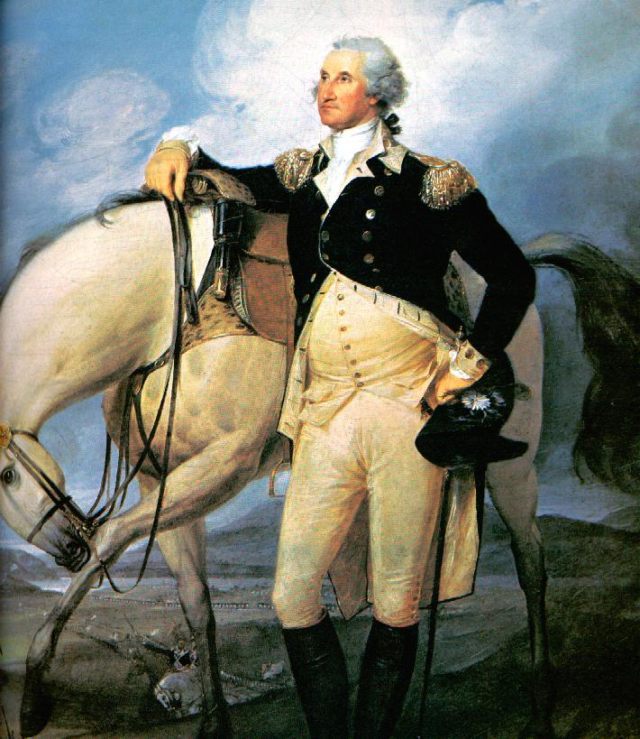
United States (1776)
Results:
Wrote a Constitution with a Bill of Rights that protected the people from government abuses
Set up a representative government where leaders were elected by representatives of the people
George Washington
(first president of the United States)

