Slide 1
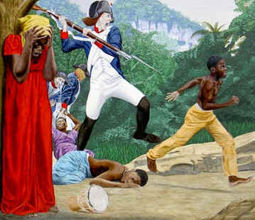
Haiti (1791)
Causes:
Slaves dominated the population by more than 10 slaves to 1 white master
Were influenced by other Revolutions around the world (France, US)
A revolt of 100,000 slaves took control of the country

Slide 2
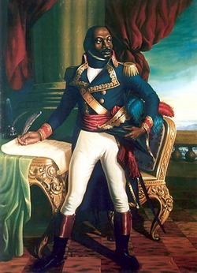
Haiti (1791)
Results:
Ended French colonial rule
First slave colony to be free of European power
Toussaint L’Ouverture
(Led the Haiti Independence Movement)

Slide 3
Latin America (1808-1825)
Causes:
Unjust social class system
Creoles traveled to Europe for their Education and were influenced by ideas of the Enlightenment
Peninsulares (Spanish born)
Creoles (American born Spanish)
Mulattos (Spanish/Black);
Mestizos (Spanish/Indian)
Indians

Slide 4
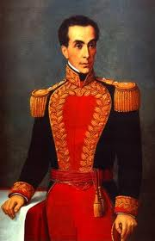
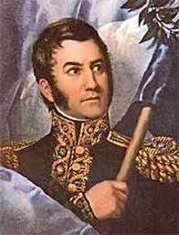
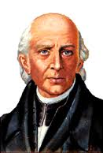
Latin America (1808-1825)
Results:
Several leaders led independence movements throughout Latin America:
Colombia, 1810
Mexico, 1810
Venezuela, 1811
Argentina, 1816
Ecuador, 1820
Peru, 1821
Brazil, 1822
Jose de San Martin
Simon Bolivar
Miguel Hidalgo

