Slide 1
Ming Dynasty China Background
The European voyages of exploration had let to opportunities of trade….By the time Portuguese ships dropped anchor off the Chinese coast in 1514, the Chinese had driven out their Mongol rulers and united under a new dynasty.
Ming Dynasty (1368-1644) Ming rulers not going to allow outsiders from distant lands to threaten peace and prosperity the Ming had brought to China .when they ended Mongol rule
The Ming dynasty was the last native Chinese dynasty in China - “Ming” means brightness, The name was chosen by the first Ming Emperor as a contrast to the dark period in which the dynasty came to power

Slide 2
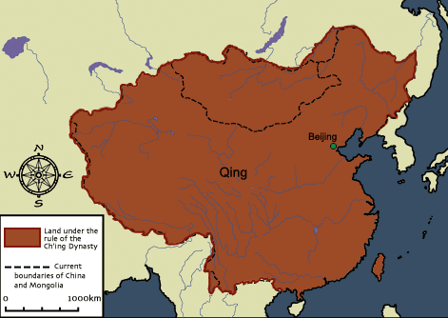
Qing Dynasty China Background
1644, Manchus invaded China and established the Qing Dynasty
ruled China for over 260 years
upheld traditional Confucian beliefs and social structures
Manchuria

Slide 3
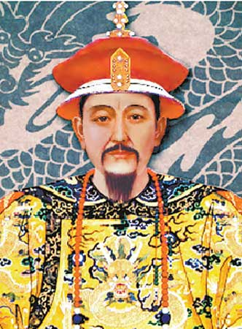
Qing Dynasty China Rulers
Kangxi (kahng shee)
Became emperor in 1661 and ruled for 60 years
Reduced government expenses
Lowered taxes
Placed intellectual people and scholars in government offices

Slide 4
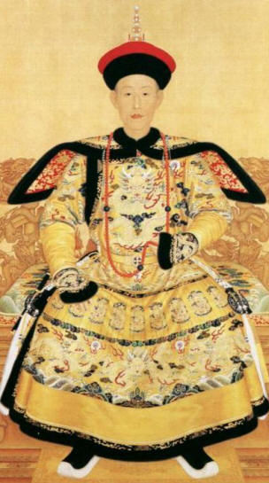
Qing Dynasty China Rulers
Qian-Long (chyahn lung)
Ruled from 1736-1795
Expanded the borders of China
Made China more prosperous

Slide 5
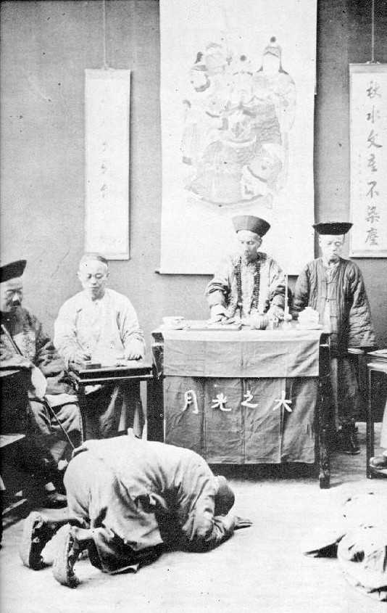
Qing Dynasty China Foreign Policy
Viewed China as the cultural center of the universe
Welcomed foreigners but made them follow many restrictions
Had to pay tribute to Qing rulers
Could only trade at certain ports
Had to “kowtow” to Qing rulers (kneel before them and touch head to the ground nine times)

Slide 6
Qing Dynasty China Society
The use of irrigation and fertilizer helped to increase food production, leading to a population increase
Men dominated the household
Families lived with paternal grandparents to ensure that aging parents could be helped with farming
Female infanticide (killing infants)
Women’s rights were very limited

