Slide 1
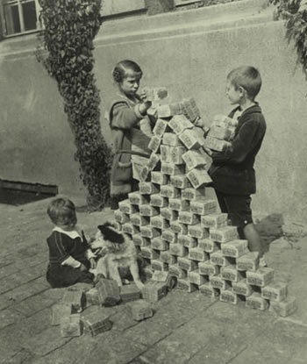
Postwar Uncertainty Instability in Europe after World War I
Economic Instability – Many European nations were in debt after a long and expensive war
Example – Germany
Germany had printed lots of extra money to pay for war expenses
As a result, the value of German currency fell

Slide 2
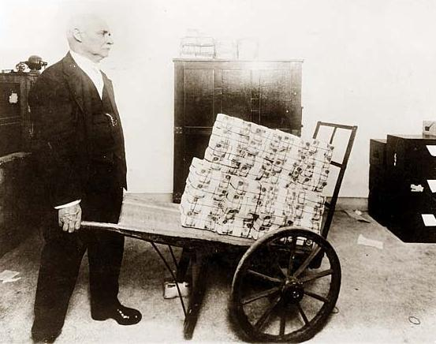
Economic Instability

Slide 3
Postwar Uncertainty Instability in Europe after World War I
Political Instability
Absolute rulers had been overthrown.
New governments had no experience with democracy.
Some countries had several political groups, making it difficult for any party to gain a majority.
Frequent changes in government made it hard to develop strong leadership.

Slide 4
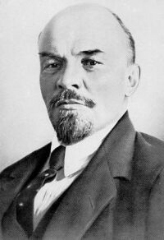
Political Instability
Example – Russia
The Bolsheviks – Extreme revolutionaries who followed Socialism and advocated for overthrowing the upper class
The Russian Revolution, 1917 – Established the Soviet Union
Lenin reorganized the country under several soviets, or local councils of workers and peasants
renamed Russia the Union of Soviet Socialist Republics (USSR).
Lenin ordered all farmland be distributed among peasants & control of factories be given to the workers.
Vladimir Lenin
Leader of the Bolsheviks and “Father of the Russian Revolution”

Slide 5
Fascism Rise in Europe
Millions of Europeans lost faith in democratic government and began looking for strong authoritarian leadership.
Fascism was a new political movement that emphasized loyalty to the state and obedience to its leader.
Fascists promised to strengthen the economy.
Fascists promised to punish those responsible for hard times.
Fascists promised to restore order and national pride.
Fascism attracted many people who felt angry about the peace treaties that followed World War I.

Slide 6
Fascism
Communism
Countries:
Germany, Italy, Japan
Countries:
Russia
Ruled by dictators
One-party rule
Denied individual rights
State is supreme
No democracy practiced
Did not seek a classes society
Believed each class had its place and function
Extreme nationalists
Wanted a classless society
Internationalists – wanted to unite workers worldwide

Slide 7
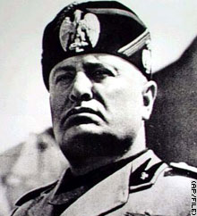
Benito Mussolini Italy
Background:
Italy did not gain any new territory in the Treaty of Versailles.
Bad economy and unemployment
Was a newspaper editor
He promised to improve the economy and strengthen the military of Italy
30,000 of his followers marched on Rome and took power of the government from the king
Abolished democracy and outlawed opposition political parties
Put all who opposed him in jail
Controlled all radio to promote fascist ideas

Slide 8
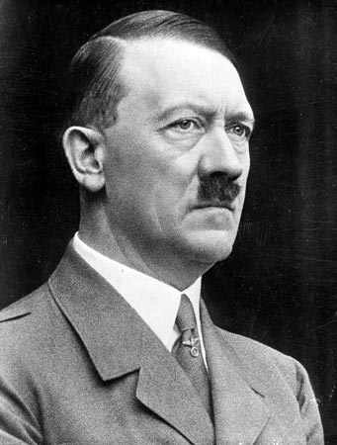
Adolf Hitler Germany
Background:
National Socialist German Worker Party (Nazi) party formed after WWI
The goal of the Nazis was overturning the treaty of Versailles
Became the leader of the Nazis
Wrote a famous book, Mien Kampf (“My Struggles”) that outlined his beliefs, including white supremacy
When the Nazis took over German government, he banned all other political parties
Formed a secret police, the SS, that murdered all his enemies
Took all authority over business and labor
Burned books that criticized the Nazi party

Slide 9
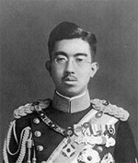
Emperor Hirohito Japan
Background:
Japanese blamed their government for economic problems
The military took over the government and installed Emperor Hirohito as head of the state
Extreme nationalism
Believed that foreign expansion would solve economic problems
Invaded China, Manchuria, and Korea
Withdrew from the League of Nations

Slide 10
Fascism Characteristics
Authoritarian leader
One political party
State is supreme
Individual rights are denied in favor of the state
Italy: Mussolini
Germany: Hitler
Japan: Hirohito

Slide 11
Fascism Concept Web
Work with ONE partner to create a Fascism concept web that describes the key traits of a fascist government in pictures & words
Use your notes & textbook pages 910-11
Requirements: 5 pictures & 5 phrases ( 2 pts each, assignment is 20 total pts)

