Slide 1
The Enlightenment

Slide 2
The Enlightenment
The Enlightenment was a European movement when thinkers attempted to apply reason to all parts of society.
New Ideas about The Right to Govern
“A government’s power comes from the consent of the governed.”
New Ideas about the Relationship between Ruler and State
“The monarch exists to serve the state and support the welfare of citizens.”

Slide 3
What did philosophers of the Enlightenment believe in?
Reason: Truth can be discovered through reason or logical thinking.
Nature: Nature is logical.
Happiness: Happiness can be found on earth, not only in heaven.
Progress: Society and humans can improve.
Liberty: People should be free.

Slide 4
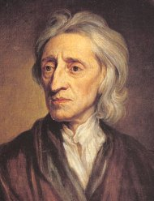
Important Individuals
John Locke
Humans can learn & improve. Humans are reasonable and have the ability to govern themselves.
Natural Rights Theory: Humans have the right to life, liberty, and property.
The job of government is to protect those rights. If it fails to do so, the people should overthrow it.

Slide 5
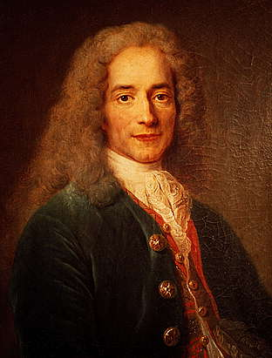
Important Individuals
Voltaire
French writer
Criticized the clergy, wealthy classes, and government in his writing
Supported tolerance, reason, freedom of religion, and freedom of speech

Slide 6
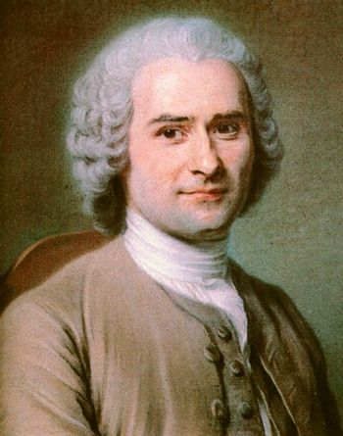
Important Individuals
Rousseau
French writer
Humans are naturally good, but are corrupted by civilization. All people are equal.
Government should be guided by the wishes of society (direct democracy).
People give control to the government in exchange for a common good.

