Slide 1
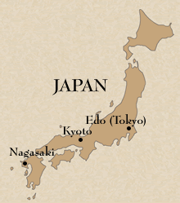
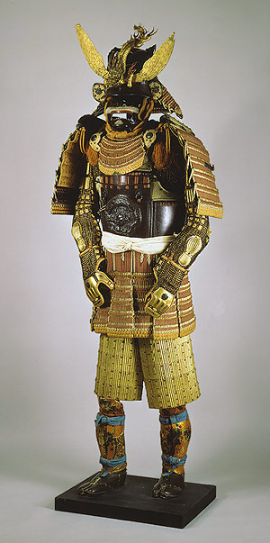
Tokugawa Japan Background
A civil war in 1467 began an era of disorder and rule by local war lords
Daimyos were feudal lords who controlled private armies of samurai warriors

Slide 2
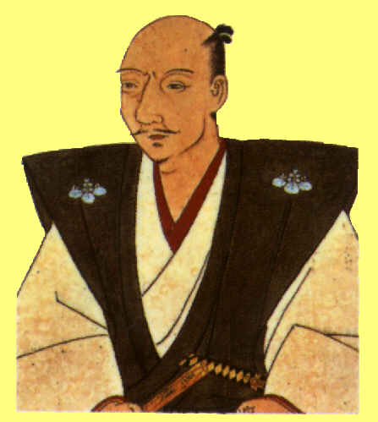
Tokugawa Japan Rulers
Oda Nobunaga (oh-dah noh-boo-nah-gah)
A powerful daimyo who seized Japan’s capital in 1568
He believed in ruling the empire by force
Eliminated all enemies
Committed suicide when one of his powerful generals betrayed him

Slide 3
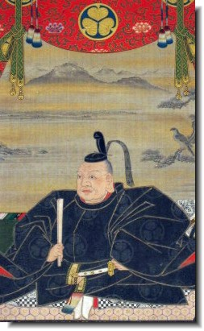
Tokugawa Japan Rulers
Tokugawa Ieyasu
(ee-ye-ya-soo)
Became the shogun, or “sole ruler”, in 1603
Unified Japan
Maintained control of daimyo by requiring them to spend half their time living in Japan’s capital & holding their families hostage when they returned home to their lands
Founded the Tokugawa Shogunate (dynasty of shoguns that ruled unified Japan until 1867)

Slide 4
Tokugawa Japan Foreign Policy
At first, welcomed foreigners
Began to dislike the influence that Christian missionaries had on Japanese culture (abandoning traditional beliefs & fear of uprising)
Banned Christianity in 1612 and began to persecute all Christians
In 1639, began a “closed country policy”
Only one port remained open to foreigners, but only Dutch and Chinese traders were allowed
Japanese were forbidden from leaving Japan

Slide 5
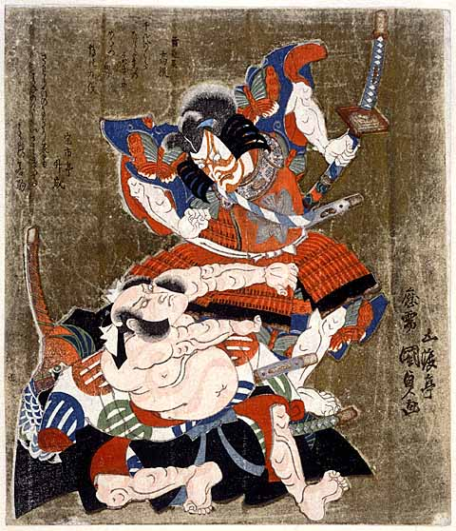
Tokugawa Japan Society
Confucian values emphasized agriculture, not business
Increased population and urbanization
Emperor (no power) , Shogun (military commander)
Daimyo (powerful landholding samurai)
Samurai (warriors)
Peasants, artisans
Merchants

