Slide 1
“A Flawed Peace”
Read pages 858 – 861 and examine the “Treaty of Versailles: Major Provisions” chart at the top of page 861.
As you read, record key ideas about the peace conference and the Treaty of Versailles in each Ticktacktoe box

Slide 2
World War I 1914-1919
Allied Powers: (Entente)
Great Britain
France
Russia (1914-1917)
USA (1917-1919)
Winners : )
Central Powers:
1. Austria-Hungary
2. Italy
3. Germany
4. Ottoman Empire (Middle East)
Losers : (

Slide 3
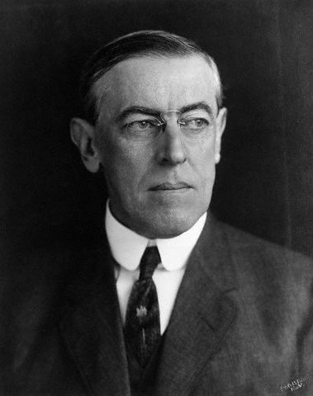
Fourteen Points
U.S. President, Woodrow Wilson
Reduce the world’s militaries
Fairness toward colonial peoples
Self-determination = allowing people to decide for themselves how they want to live

Slide 4
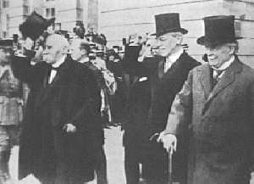
Treaty of Versailles Paris, 1919
Outlined the terms of peace
30 nations present
Big 3: Great Britain, France, United States
Written by allies, not central powers

Slide 5
League of Nations
Goal: To keep peace among nations
Based in Switzerland
Oral, Economic, and Physical Sanctions
United States refused to join
Russia & Germany prevented from joining

Slide 6
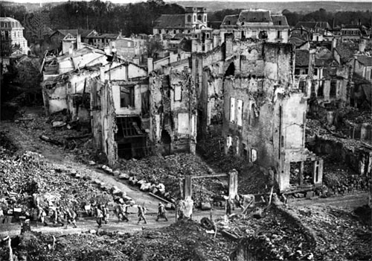
Reparations
Germany had to “repair” Europe
Agreed to pay for 100% of damages caused by the war

Slide 7
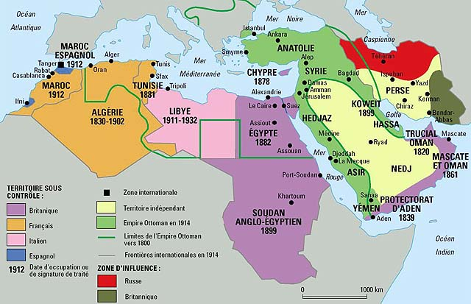
The Mandate System
Germany lost colonial territories
German and Ottoman colonies were assigned to one of the allied powers
Allies had to prepare colonies for freedom
Governance of the colonies was overseen by the League of Nations

Slide 8
Europe divided the Middle East
French Territory:
1. Syria and Lebanon
British Territory:
Palestine (Modern day Israel and Jordan)
Iraq
Independent:
Turkey
Saudi Arabia
Iran

Slide 9
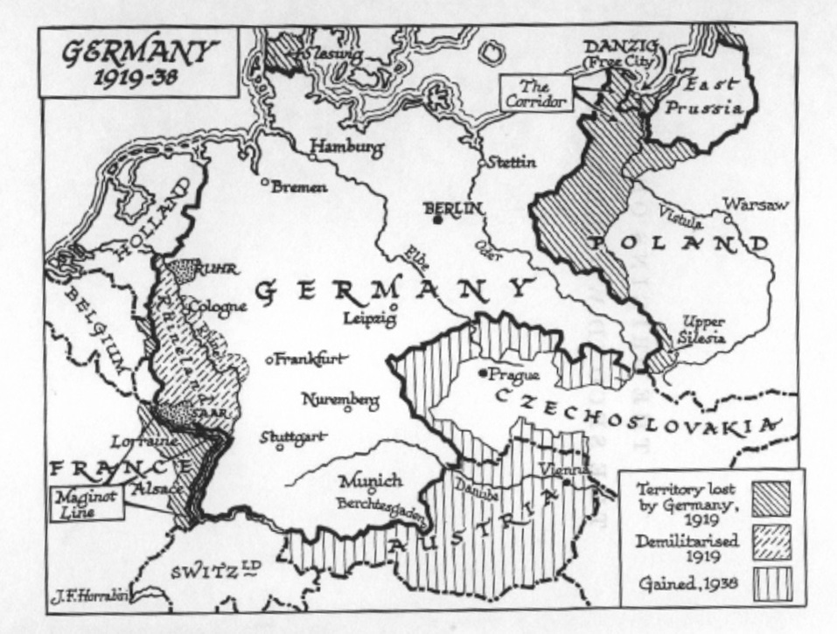
Demilitarization
Germany had to demilitarize (remove all military forces from conquered territory)

Slide 10
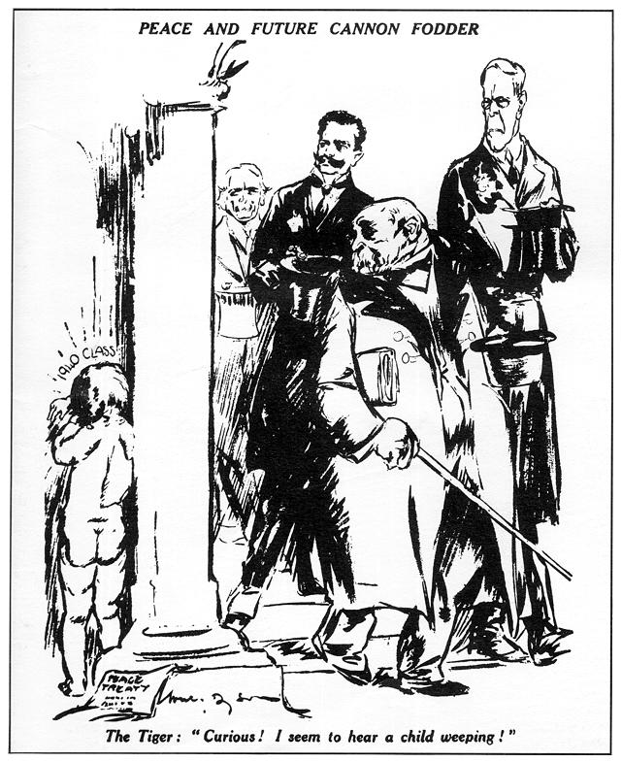
War Guilt Clause
Germany had to admit total responsibility for the war and its outcomes
This left a feeling of bitterness and hatred with the German people

Slide 11
A peace built on quicksand…

